Slide 1
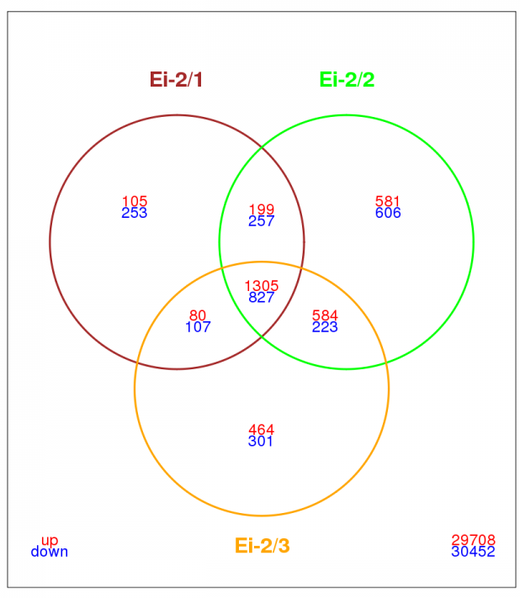
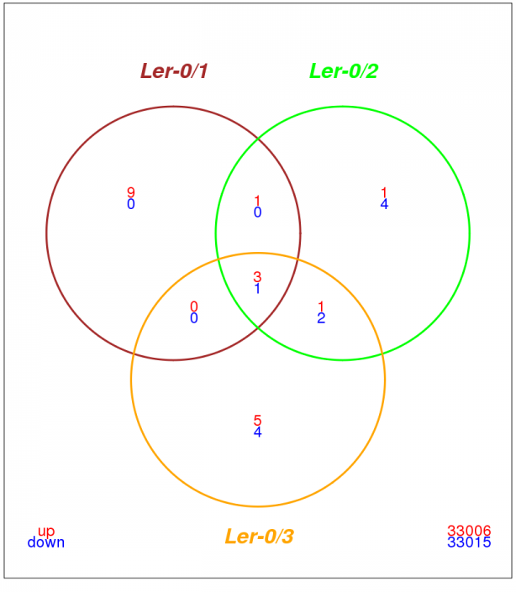
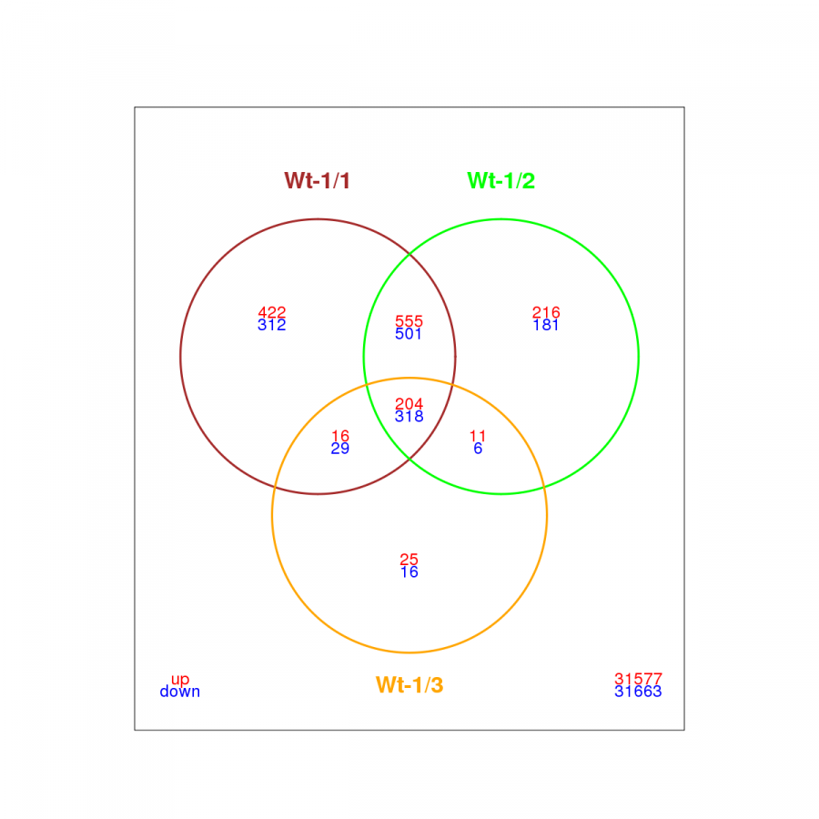
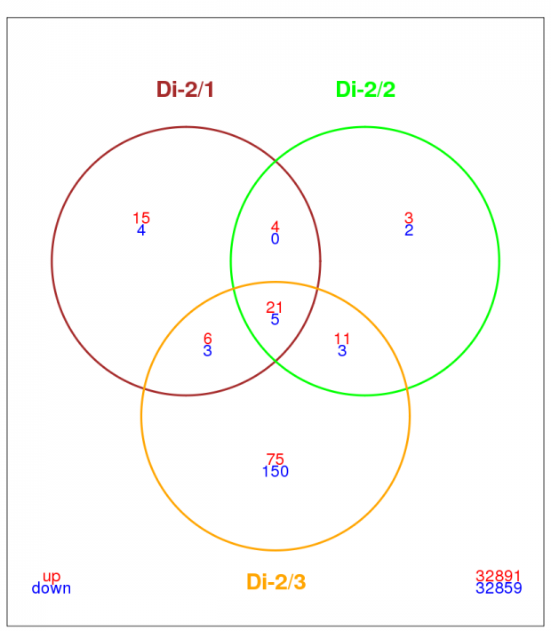
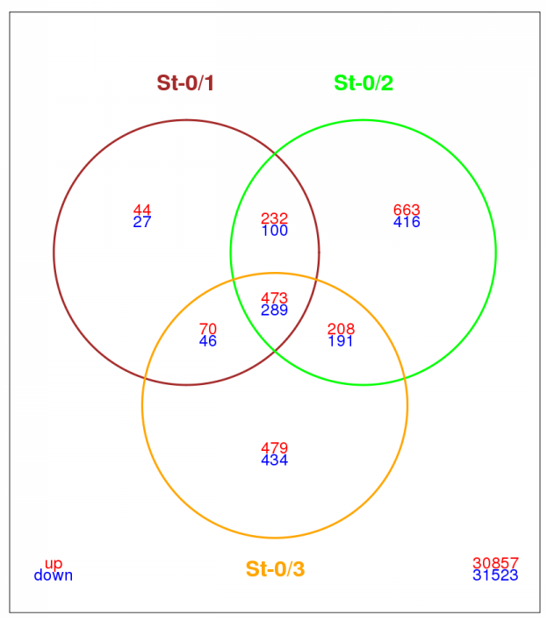
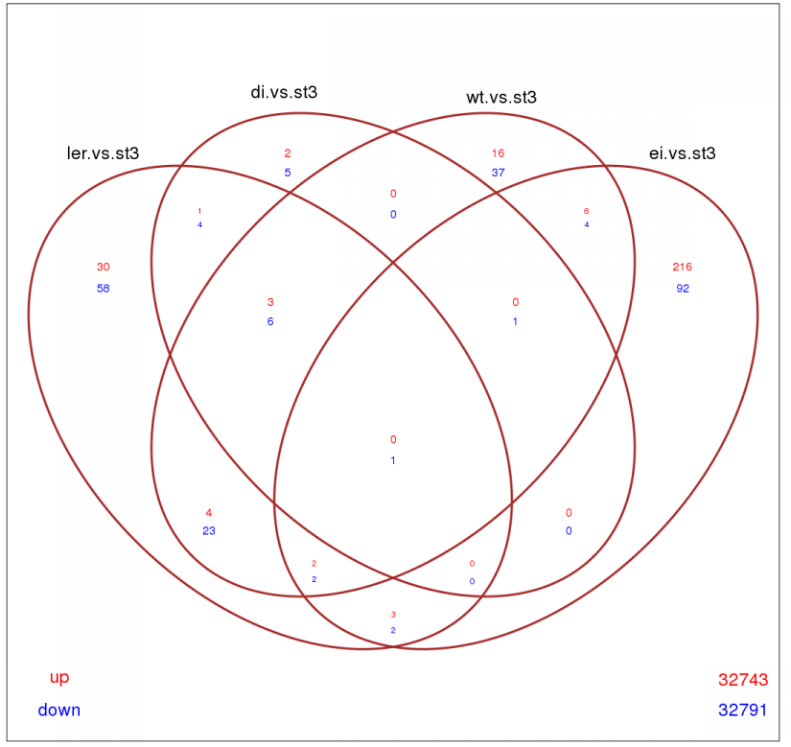
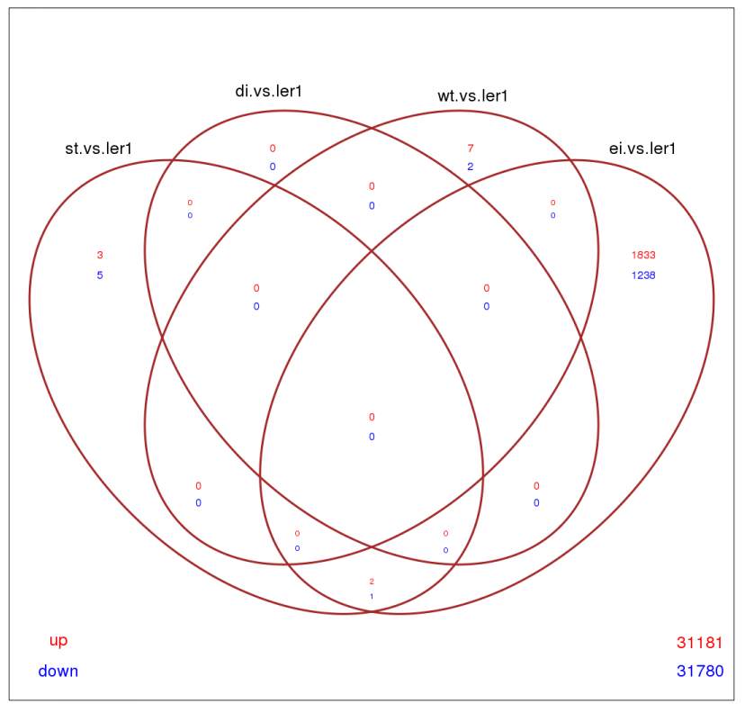
The role of genetic diversity of the host species on the adaptation of an emerging plant RNA virus
Julia Hillung¹, F. García-García², José M. Cuevas¹, Santiago F. Elena^{1,3}
¹ Instituto de Biología Molecular y Celular de Plantas, CSIC-UPV, València, Spain.
² Centro de investigación Príncipe Felipe, València, Spain.
³ The Santa Fe Institute, Santa Fe NM, USA.
Introduction
In recent years we have been evaluating to what extent the genetic diversity of the host conditions the evolutionary fate of a plant RNA virus (Lalić et al. 2010). To this end we performed a 3-fold replicated evolution experiment with Tobacco etch potyvirus isolate At17b (TEV-At17b) in a set of five genetically heterogeneous ecotypes of Arabidopsis thaliana that differ in their susceptibility to infection. The questions we wanted to answer with these studies were (i) do genetic variability in host’s response to infection favors diverse virus adaptive strategies? (ii) Do permissive host genotypes promote local virus adaptation? (iii) Do generalist viruses evolve the ability to infect equally well permissive and resistant host genotypes? (iv) What are the differences in gene expression patterns underlying these different interactions? In a recently published article, we have shown that the evolved viruses have diversified both genetically and phenotypically, showing higher infectivity and stronger virulence on their local ecotypes (Hillung et al. 2014). In this communication we follow up this work and focus in the last question: how does evolutionary history affects the way virus and plant ecotypes interact? To answer this question we undertook a comparative transcriptomic approach.
1. Evolved vs ancestral viruses in their local ecotype
…
…
…
…
…
(C)
 | Host ecotype
Viral linage (evolved) | Ler-0 | St-0 | Di-2 | Wt-1 | Ei-2
Ler-0/1 | 3 | 3 | 3 | 3 | 3
Ler-0/2 | 3
Ler-0/3 | 3
St-0/1 | - | 3
St-0/2 | 3 | 3
St-0/3 | 3 | 3 | 3 | 3 | 3
Di-2/1 | 3 |  | 3
Di-2/2 | 3 |  | 3
Di-2/3 | 3 |  | 3
Wt-1/1 | 3 |  |  | 3
Wt-1/2 | 3 |  |  | 3
Wt-1/3 | 3 |  |  | 3
Ei-2/1 | 3 |  |  |  | 3
Ei-2/2 | 3 |  |  |  | 3
Ei-2/3 | 3 |  |  |  | 3
evolved in
Ler-0
Wt-1
Ei-2
St-0
Di-2
inoculated
unselected
ecotype
Ler-0
Wt-1
Ei-2
St-0
Di-2
(B)
Viral lineage (ancestor) | Host ecotype
 | Ler-0 | St-0 | Di-2 | Wt-1 | Ei-2
TEV-At17b | 5 | 5 | 5 | 5 | 5
Experimental design (A) Cross infection of local and alternative A. thaliana hosts with evolved virus-lineages. (B) and (C), representation of samples used for transcriptomic characterization via Agilent microarray technology: (B) samples from plants infected with the ancestral TEV-At17b virus. (C) samples from inoculations with viruses evolved in (A). Numbers in the tables represent the number of individually analyzed plants for a given host-virus combination. Shadowed numbers are combinations of virus with his local host.
3. The most specialist and most generalist lineages in all hosts vs in local host
Transcriptomic analysis 3. Venn diagrams represent the number of differentially expressed genes in each ecotype. Ellipses indicate the number of differentially expressed genes in alternative host ecotypes in comparison to the local host for an evolved virus lineage. The overlapping areas of the ellipses represent the number of common genes among ecotypes. Ler-0/1 is the most specialized lineage and St-0/3 the most generalist one.
Transcriptomic analysis 1. Evolved virus lineages in their local ecotypes compared to the ancestral virus (Hillung et al. 2012). Venn diagrams represent the number of differentially expressed genes in each ecotype. Each circle indicates an independent replicate of viral evolution. The combined areas of the circles represent the number of overlapping genes between independent lineages. ‘‘TreeMap’’ view of REVIGO (http://revigo.irb.hr/). Each rectangle represent a cluster of GO terms. The clusters are joined into superclusters of related terms, visualized with different colors. The size of the rectangles reflects the adjust p-value. For ecotypes Ler-0 and Di-2 no significant GO terms could by determined, because of low number of altered genes.
2. Locally adapted vs ancestral viruses in the original host (Ler-0)
Conclusions
Genetic differences among host ecotypes promoted a divergence in the adaptive targets of TEV-At17b.
The lists of genes targeted by each locally adapted virus depends upon the ecotype wherein evolution took place. Independent lineages evolved in a common ecotype show overlapping lists of genes (convergent evolution).
With the exception of ecotype Ei-2, there most permissive ecotypes show weaker response to virus infection than more resistant ecotypes (lower number of altered genes).
Virus-host interactions have undergone changes in the most lineages during adaptation to a new ecotype.
Most of the genes altered by the evolved viruses, compared to the ancestral virus, are implicated in metabolic and growth processes, not in immune responses, indicating that the immune response was not the main selective target during this adaptive radiation. Possibly due to the previous common phase of adaptation to Ler-0 in which surpassing immune responses was essential.
Adaptation to the local host ecotype does not involve changes in the interaction with the original ecotype Ler-0.
The most generalist case of viral lineage alter smaller set of genes then the more specialist virus. Specialist lineage shows more heterogeneity in the altered set of genes.
Viral lineage | Down | Up
Di 1 | 0 | 0
Di 2 | 0 | 0
Di 3 | 1 | 1
St 2 | 0 | 0
St 3 | 0 | 0
Wt 1 | 0 | 0
Wt 2 | 0 | 5
Wt 3 | 1 | 0
Ei 1 | 0 | 1
Ei 2 | 0 | 0
Ei 3 | 0 | 0
References:
Transcriptomic analysis 2. The number of differentially expressed genes of evolved lineages infecting the original ecotype (Ler-0) in comparison to ancestral virus infecting the same ecotype.
Hillung J, Cuevas JM, Elena SF. (2012) Front. Microbiol. 3: 229.
Hillung J, Cuevas JM, Valverde S, Elena SF. (2014) Evolution doi: 10.1111/evo.12458.
Lalić J, Agudelo-Romero P, Carrasco P, Elena SF. (2010) Phil. Trans. R. Soc. B 65: 1997-2008.
Funding:

